Slide 1
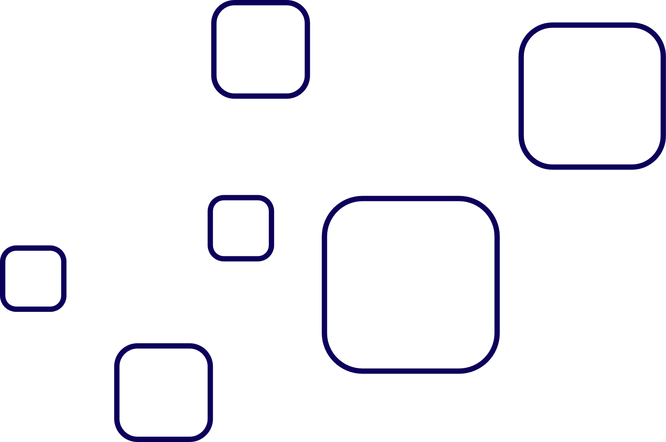
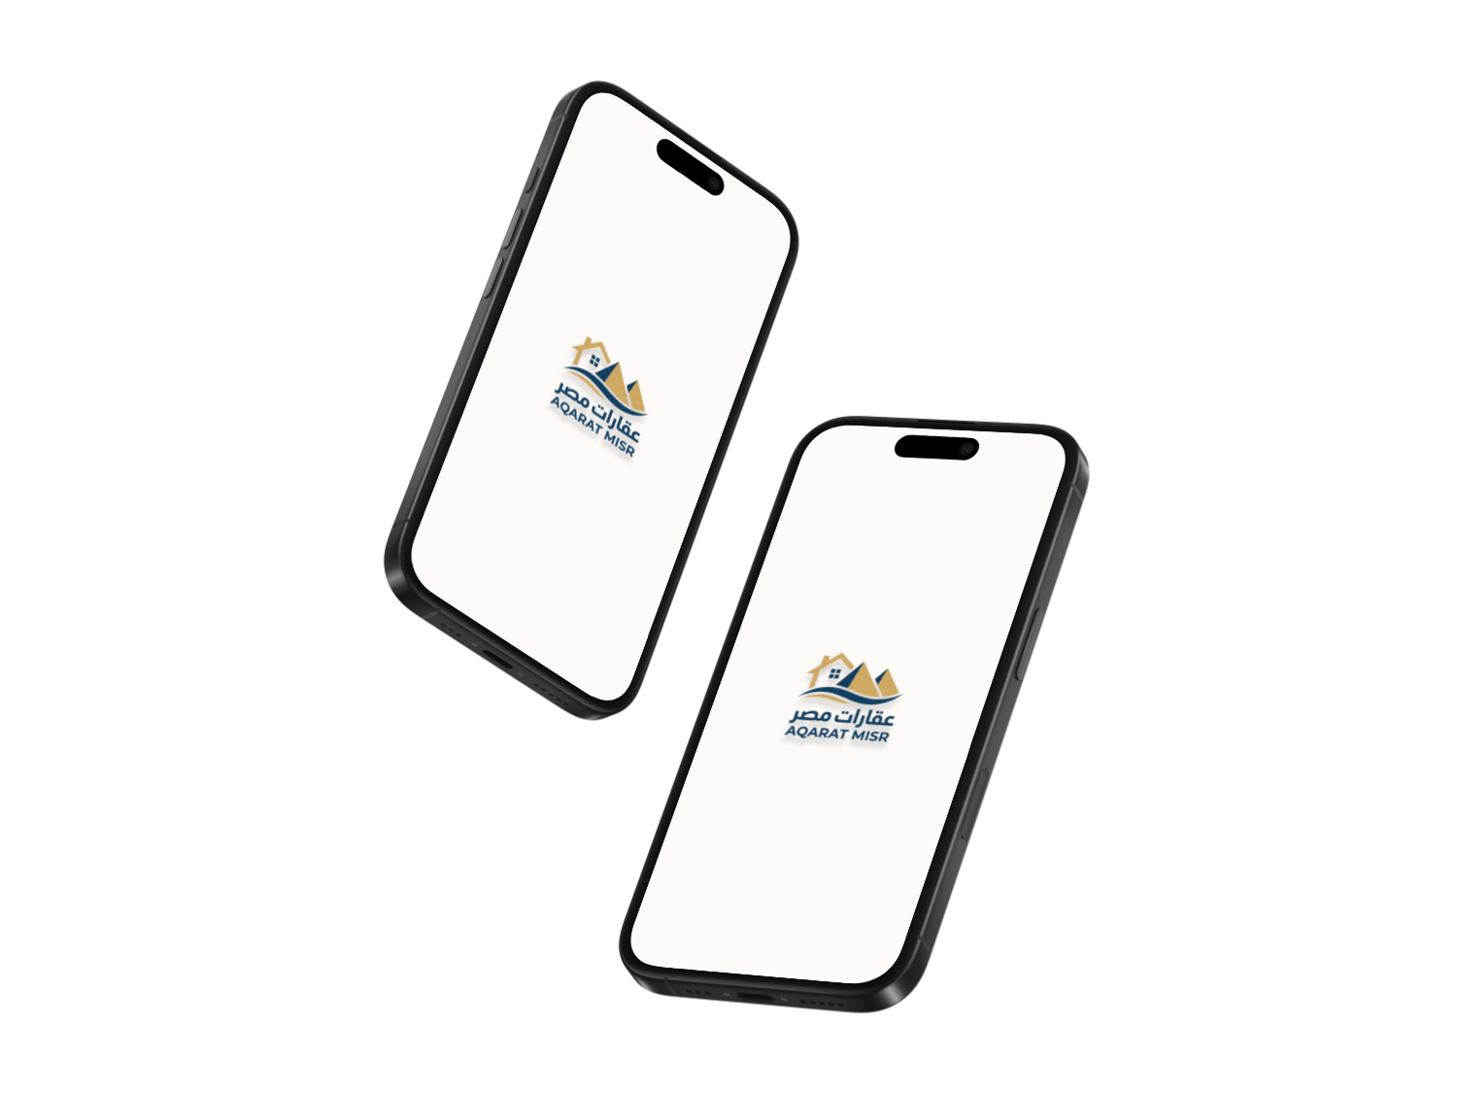


Aqarat Masr
UI&UX Redesign

Slide 2

Team Project
Ahmed Nagy
1
Muhamed Ahmed
2
Abdallah Elkady
3
Mahmoud Ahmed
4
Ammar Alaa
5

Slide 3
Introduction
UI (User Interface): Focuses on the visual design, such as colors, buttons, and layout.
UX (User Experience): Focuses on how users interact with the product and how easy it is to use
UX Principles:
Usability – Easy and clear to use
1
Consistency – Same design patterns across screens
2
Feedback: Clear response to user actions
3

Slide 4
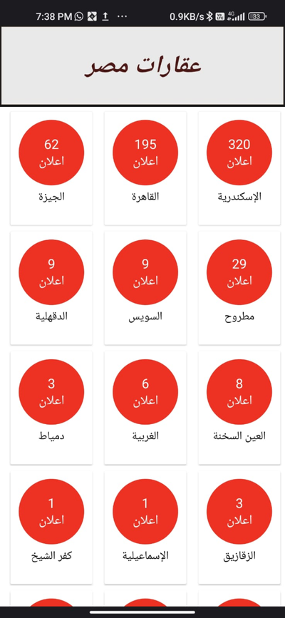
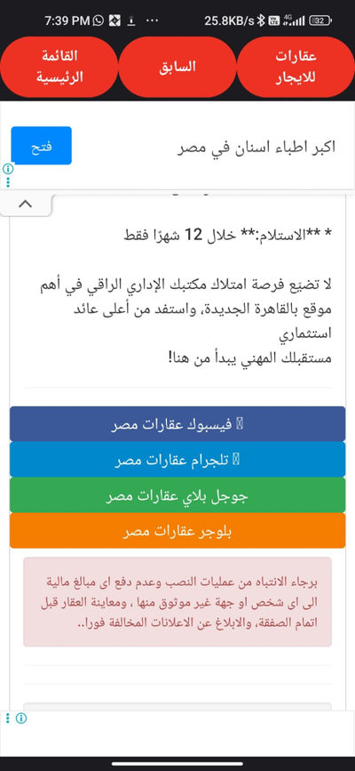
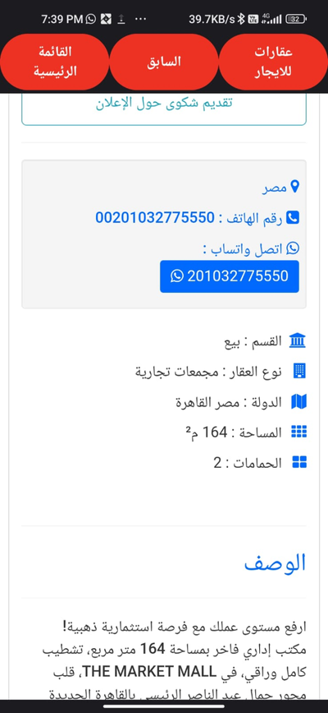
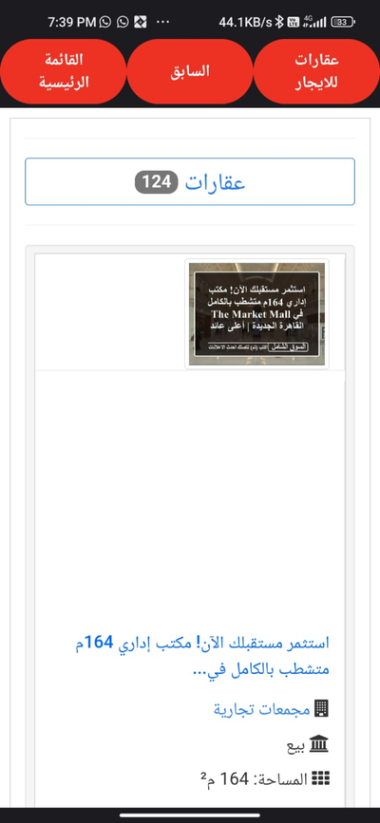

The Problem
1
Inconsistent UI components
2
Outdated visual identity
3
Unclear navigation

Slide 5
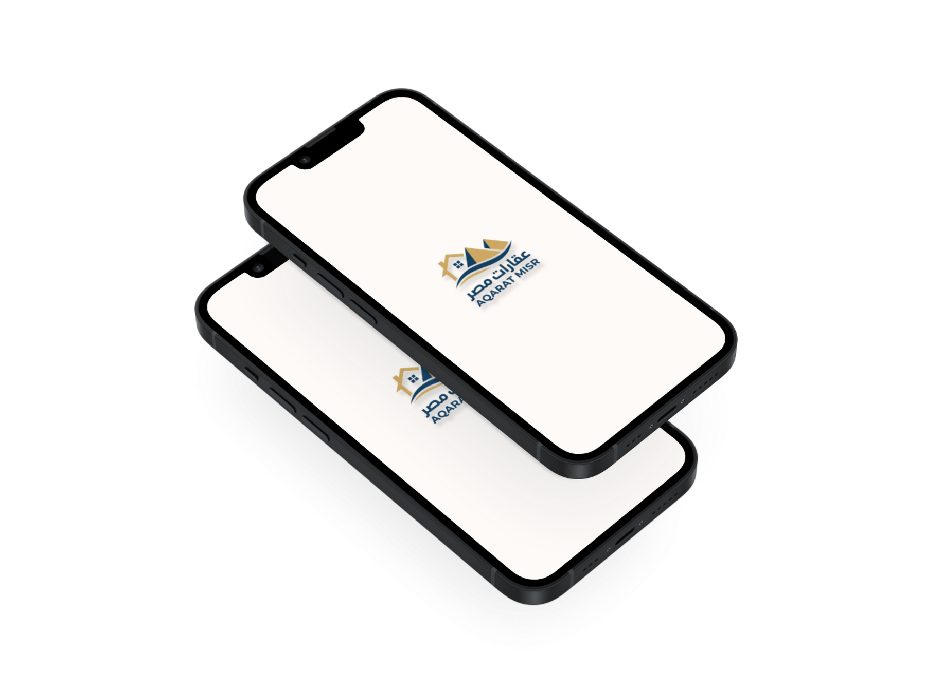

Our Goal
1
Redesign the visual identity
2
Improve user experience
3
Create a consistent design system

Slide 6

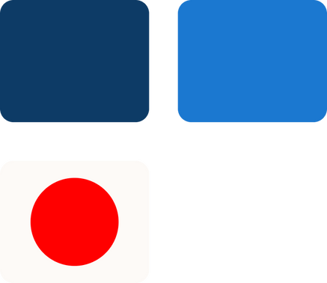

Brand Redesign
New Logo
New Color Pallet
Updated Typography

Slide 7
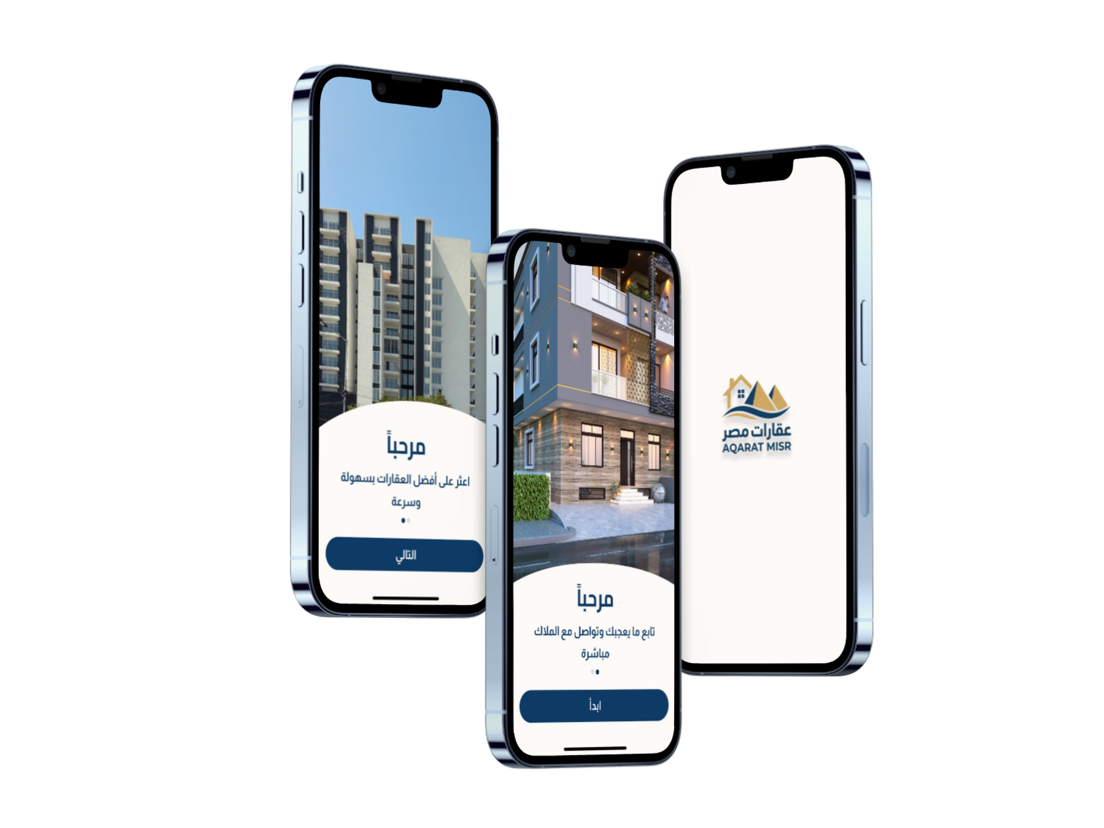
Splash and Onboarding Redesign
1
Strong and consistent brand identity
2
Clear onboarding flow for new users
3
Strong first impression from the first interaction
4
Improved visual hierarchy and readability
4
3

Slide 8
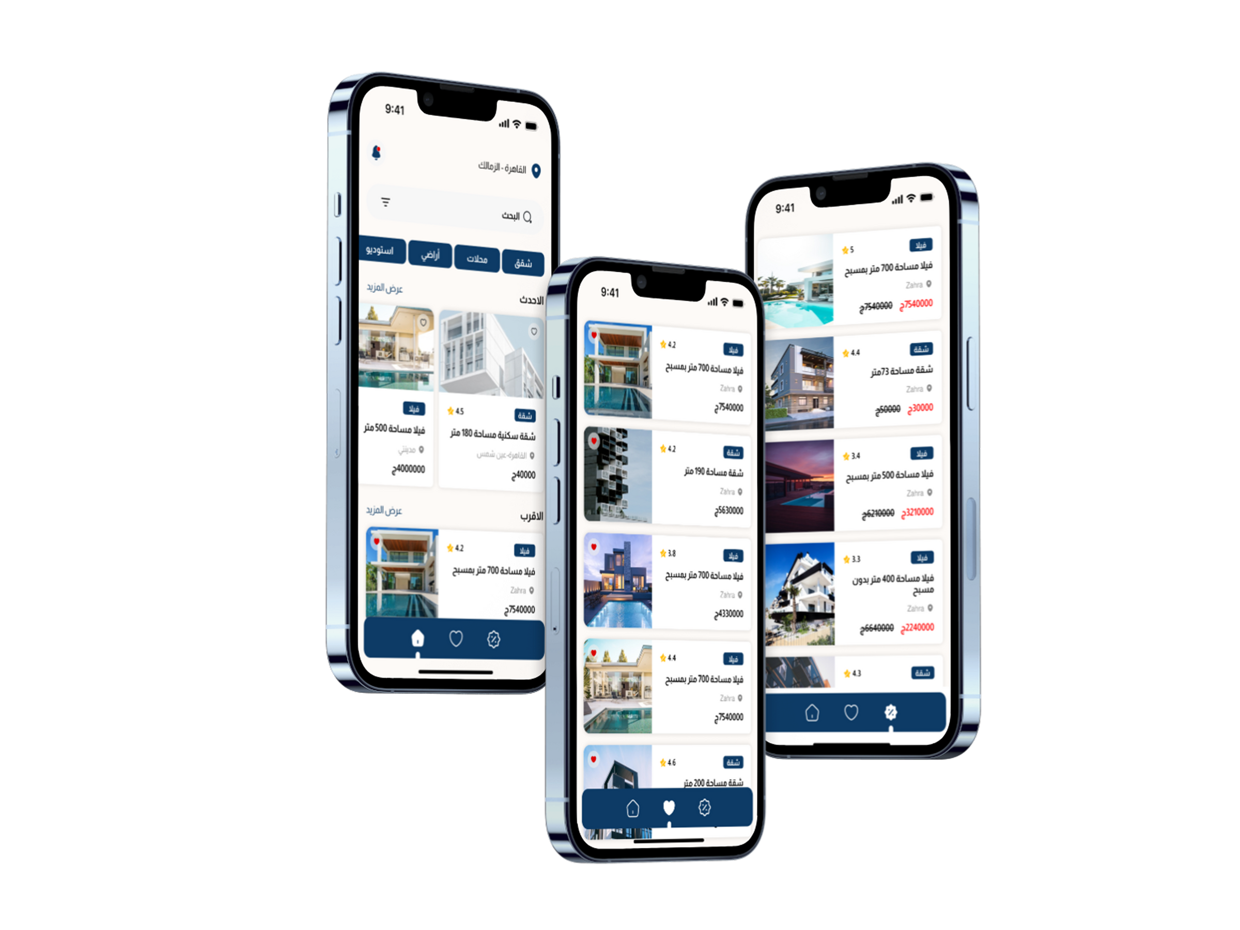
Main Screens
1
Home Screen
2
Favorite Screen
3
Offers Screen

Slide 9
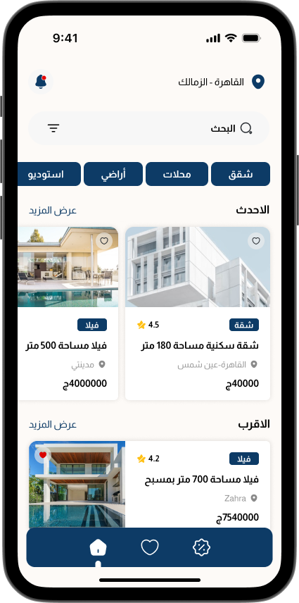
Home Screen Redesign
1
2
Clear and modern layout for easier browsing
Highlighted main actions
(Search, Categories, Listings)
3
4
Better content organization and clarity
Improved overall user experience

Slide 10
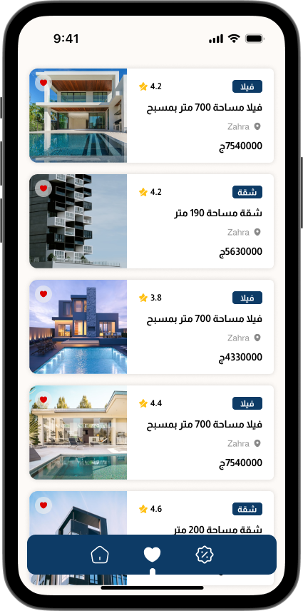
Fav Screen Redesign
1
2
Easy access to saved properties
Clear and organized list view
3
Improved overall browsing experience

Slide 11
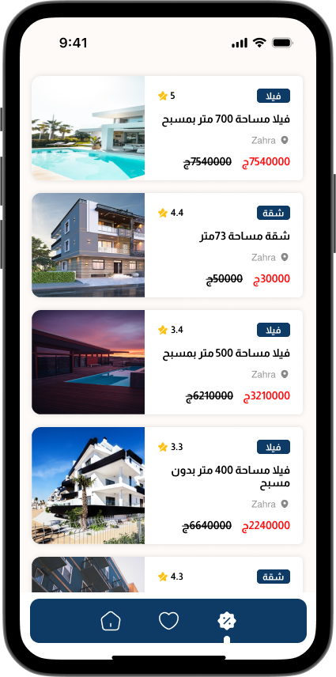
Offers Screen
1
2
Highlight special deals and discounts
Increase user engagement
3
4
Supports user decision-making
Easy discovery of offers

Slide 12

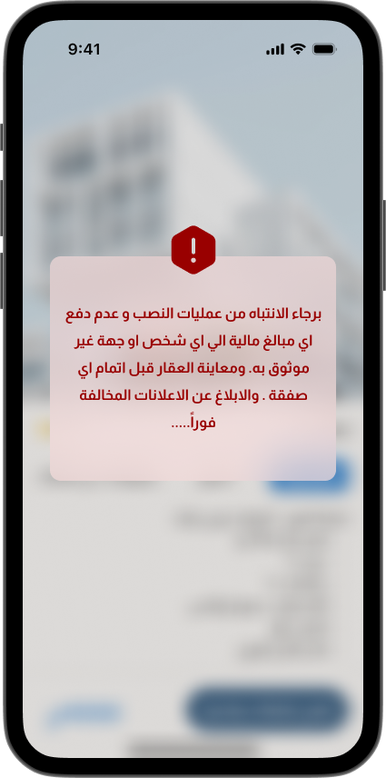
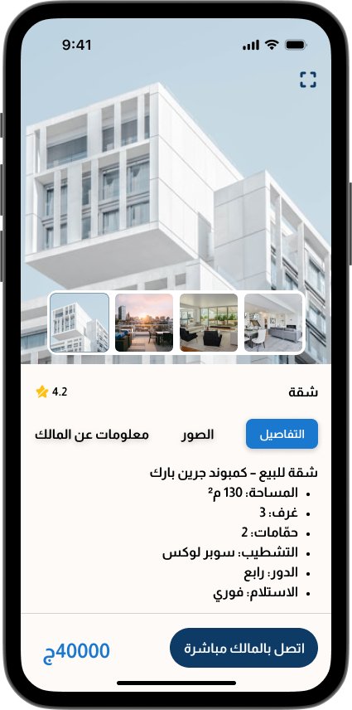
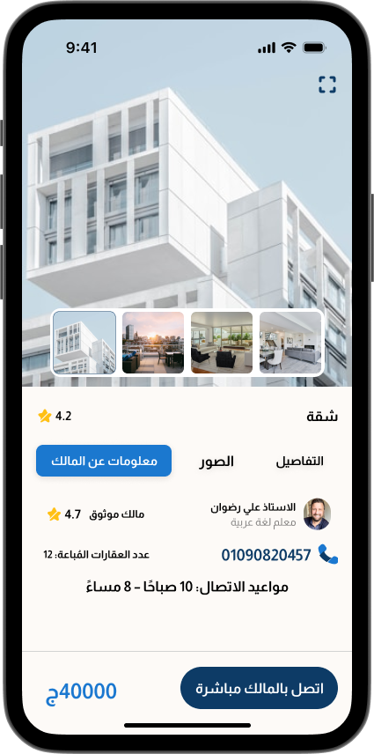
User Flow

Slide 13
Warning Screen
1
2
Inform users about the result of their actions
Immediate feedback after user actions
3
4
Clear and understandable messages
Consistent visual style with the app identity

Slide 14
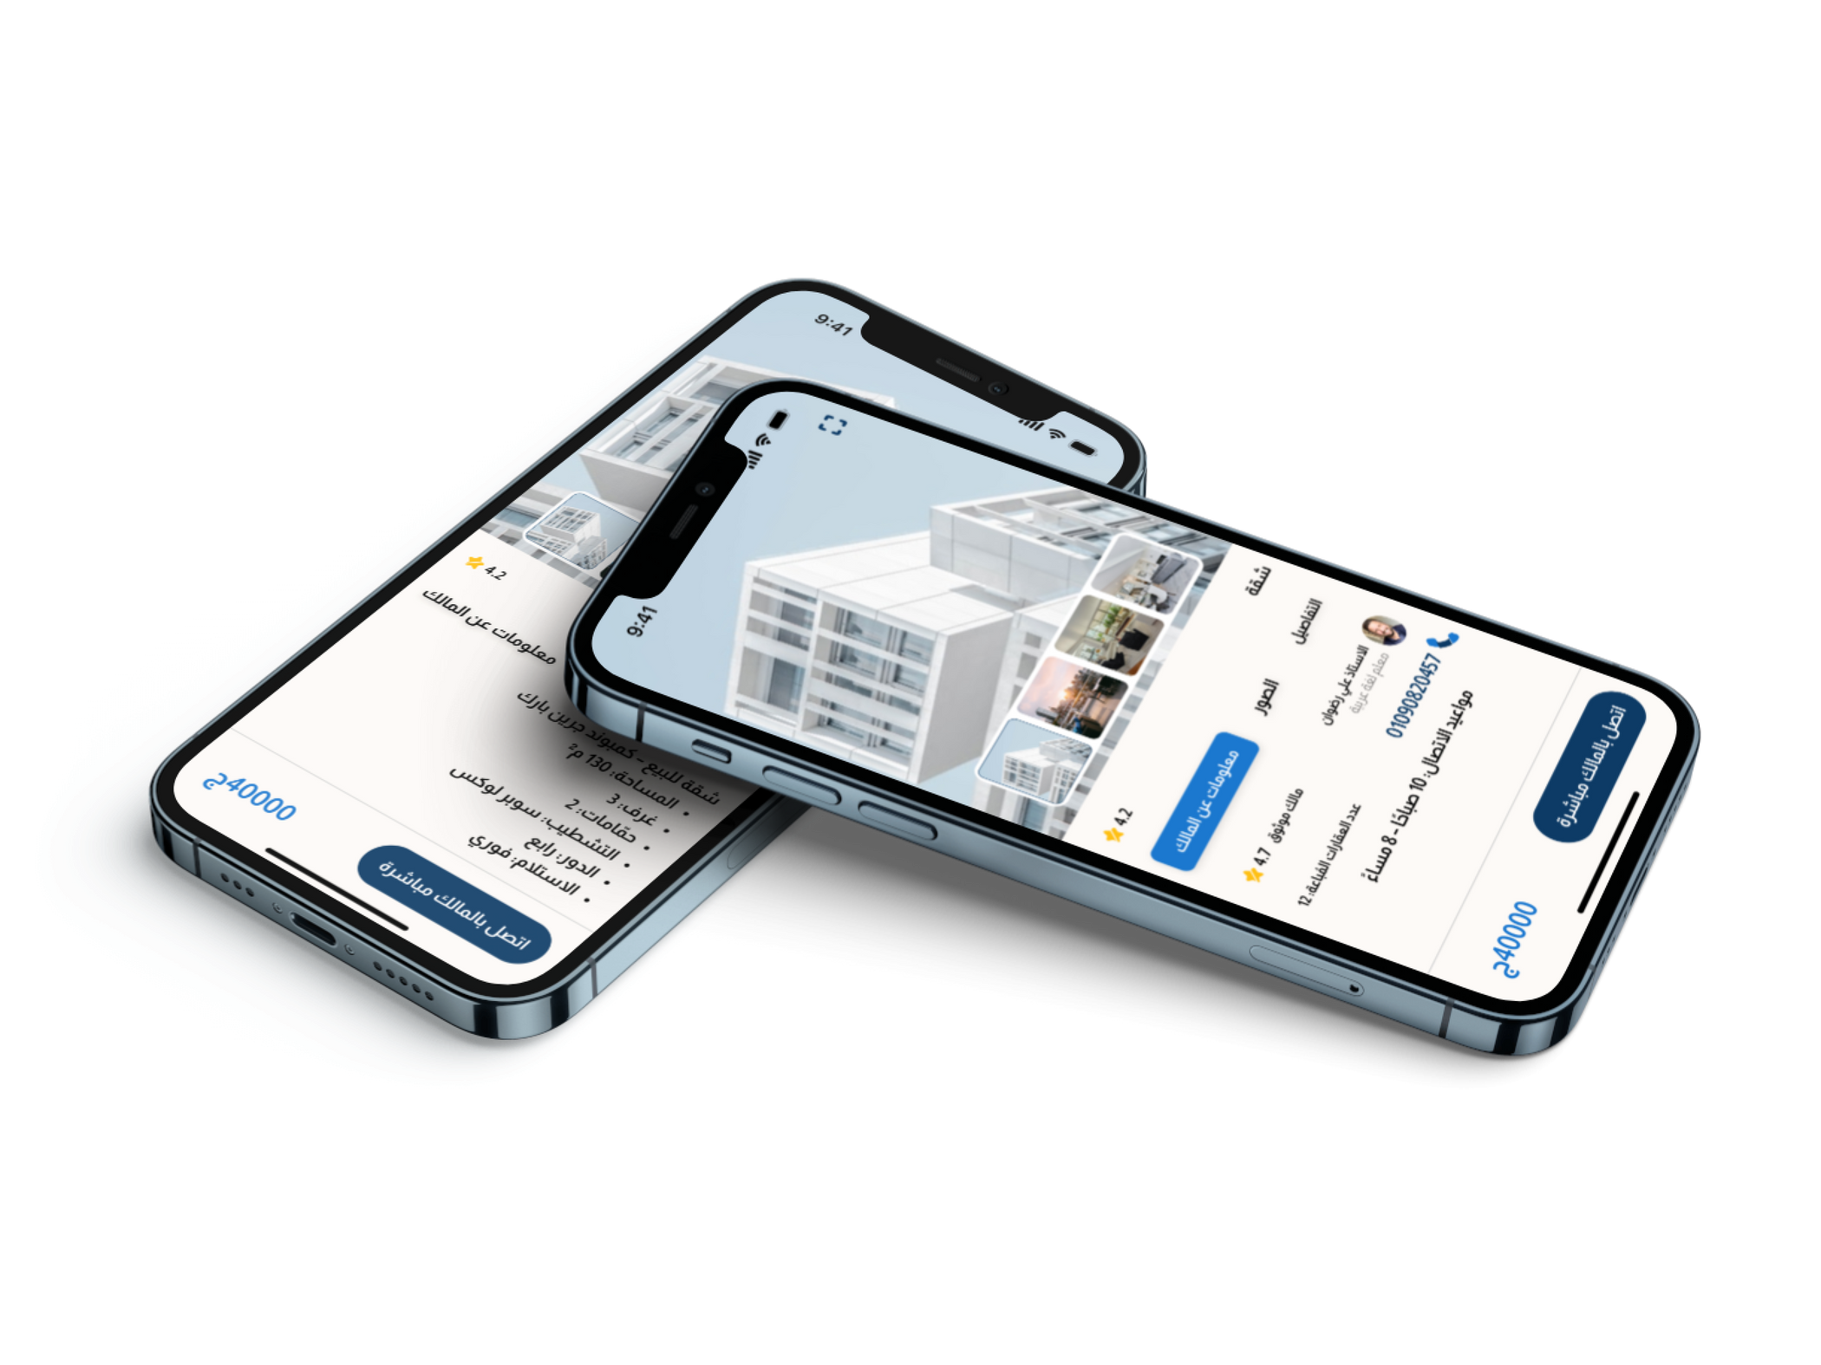
Details Screen
1
Clear and well-organized property information
Easy access to contact and action buttons
2

Slide 15

Key Improvements in Aqarat Masr App
Stronger Brand Identity
Improved User Experience
Better Usability
A modern and consistent visual identity across the entire application.
Simpler flows, clearer actions, and smoother interactions.
Easier navigation, clearer information, and features that encourage user action.

Slide 16
Project Analysis
For more details about the research, analysis, and design decisions, check the full Project Analysis Document.

Slide 17

Final View
Click Here

Slide 18


